Slide 1
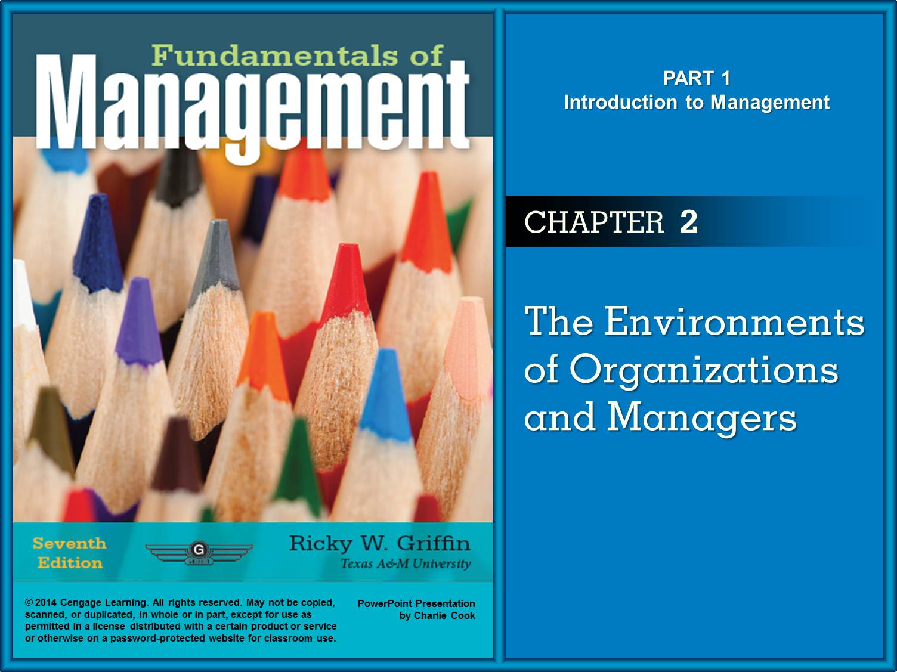

Slide 2

Chapter Learning Objectives After studying this chapter you should be able to:
Discuss the nature of an organization’s environments and identify the components of its general, task, and internal environments.
Describe the ethical and social environment of management, including individual ethics, the concept of social responsibility, and how organizations can manage social responsibility.
Discuss the international environment of management, including trends in international business, levels of international business activities, and the context of international business.
Describe the importance and determinants of an organization’s culture, as well as how organization culture can be managed.

Slide 3
Environment
An organization’s environment is a major consideration in strategic assessment.
The environment is the source of resources that the organization needs.
It provides opportunities and threats,
It influences the various strategic decisions that executives must make.

Slide 4
Environment.
For any organization, the environment consists of the set of external conditions and forces that have the potential to influence the organization.

Slide 5
Environment
It is useful to break the concept of the competitive environment for a business down into two components: the general environment and its industry.
The general environment, includes overall trends and events in society such as social trends, technological trends, demographics, and economic conditions.
The industry, or competitive environment, consists of multiple organizations that collectively compete with one another by providing similar goods, services, or both.

Slide 6
Environment
Every action that an organization takes, such as raising its prices or launching an advertising campaign, creates some degree of change in the world around it.
Most organizations are limited to influencing their industry.

Slide 7
“no man is an island.”
Similarly, it is accurate to say that no organization is self-sufficient.
As the human body must consume oxygen, food, and water, an organization needs to take in resources such as labor, money, and raw materials from outside its boundaries.
An organization cannot survive without the support of its environment.

Slide 8
No man is an Island
Second, the environment is a source of opportunities and threats for an organization.
Covid was a prime example
Third, the environment shapes the various strategic decisions that executives make as they attempt to lead their organizations to success.

Slide 9
Example.
A firm that sets a goal of increasing annual sales by 50% might struggle to achieve this goal during an economic recession or if several new competitors enter its market.
Environmental conditions also need to be taken into account when examining whether to start doing business in a new country, acquire another company, or launch an innovative product, to name just a few.

Slide 10
The Organization’s Environments
External Environment
General environment is a set of broad dimensions and forces in an organization’s surroundings that determine its overall context
Task environment is composed of specific groups and organizations that affect the firm.
Internal Environment
Conditions and forces within an organization.
Notes:
3

Slide 11
The Organization and Its Environments
Technological dimension
Competitors
Owners
Regulators
Employees
Customers
Physical environment
Board of directors
Political-
Culture
legal
Economic
dimension
Strategic
Suppliers
dimension
partners
Internal environment
Task environment
External environment
General environment

Slide 12
The External Environment
The General Environment
Economic dimension
Technological dimension
Political-legal dimension
Notes:
7

Slide 13
The External Environment (cont’d)
Dimensions of the Task Environment
Specific groups affecting the organization
Competitors
Customers
Suppliers
Regulators (agencies and interest groups)
Strategic partners (allies)
Notes:
9

Slide 14
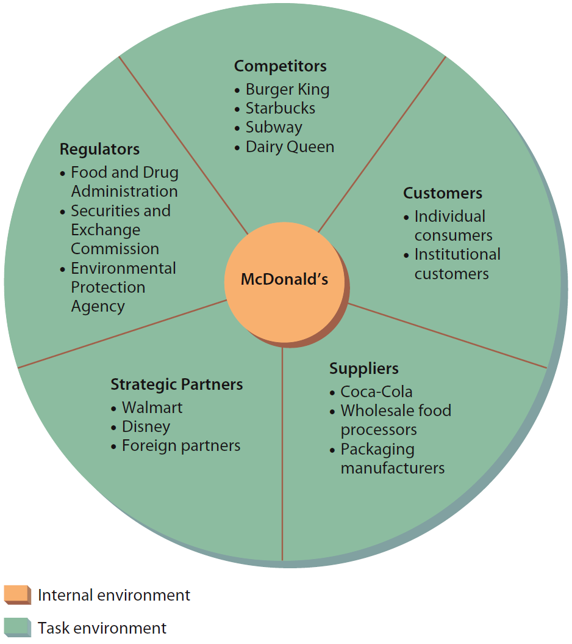
FIGURE 2.1
McDonald’s Task Environment

Slide 15
The Internal Environment
Conditions and forces within an organization
Owners with legal property rights to a business.
Board of directors who oversee management of the firm to best serve stockholders’ interest.
Employees who work for the firm and have a vested interest in its continued operation and existence.
Physical work environment of the organization and the work that people do.
Notes:
11

Slide 16

How Organizations and Environments Interact
Environments
Change and Complexity
Competitive Forces
Turbulence
Organization Environment Interface
Information Management
Strategic Response
Mergers, Takeovers, Acquisitions, Alliances
Organization Design and Flexibility
Direct Influence
Organizations

Slide 17
Individual Ethics In Organizations
Ethics
An individual’s personal beliefs regarding what is right or wrong or good or bad.
Ethical Behavior
Behavior that is acceptable in the eye of the beholder.
Behavior that conforms to accepted social norms.
Examples of Unethical Behavior
“Borrowing” office supplies for personal use.
Checking Facebook on company time.

Slide 18
Determinants of Individual Ethics
Family Influences
Situational Factors
Values and Morals
Experiences
Peer Influences
Individual Ethics

Slide 19

Managerial Ethics
•
Conflicts of interest
•
Secrecy and
confidentiality
•
Honesty
Employees
Organization
•
Hiring and firing
•
Wages and working
Areas of concern for managerial ethics:
How the firm treats the employee.
How the employee treats the firm.
How the firm treats other economic agents.
How the firm handles its financial reporting
conditions
•
Privacy and respect
Subject to ethical ambiguities
•
Advertising and promotions
•
Ordering and purchasing
•
Bargaining and negotiation
•
Financial disclosure
•
Shipping and solicitation
•
Other business relationships
Economic Agents
•
Customers
•
Competitors
•
Stockholders
•
Suppliers
•
Dealers
•
Unions

Slide 20




Fostering Ethical Organization Behavior
Managing Ethical Behavior
Top Management Involvement
Train Employees
Written Code of Ethics
Individual Issues: Behavior, Conscience, Privacy

Slide 21
Ethics in Organizations
Managing Ethical Behavior
Begins with top management that:
Establishes a strong culture and defines what will and will not be acceptable behavior.
Provides ethical leadership by serving as ethical role models.
Includes
Training on how to handle ethical dilemmas.
Developing a code of ethics.

Slide 22
Emerging Ethical Issues
Ethical Leadership (Integrity)
Corporate Governance (Sarbanes-Oxley Act)
Ethical Issues in Organizations
Ethics and Information Technology (Privacy)

Slide 23
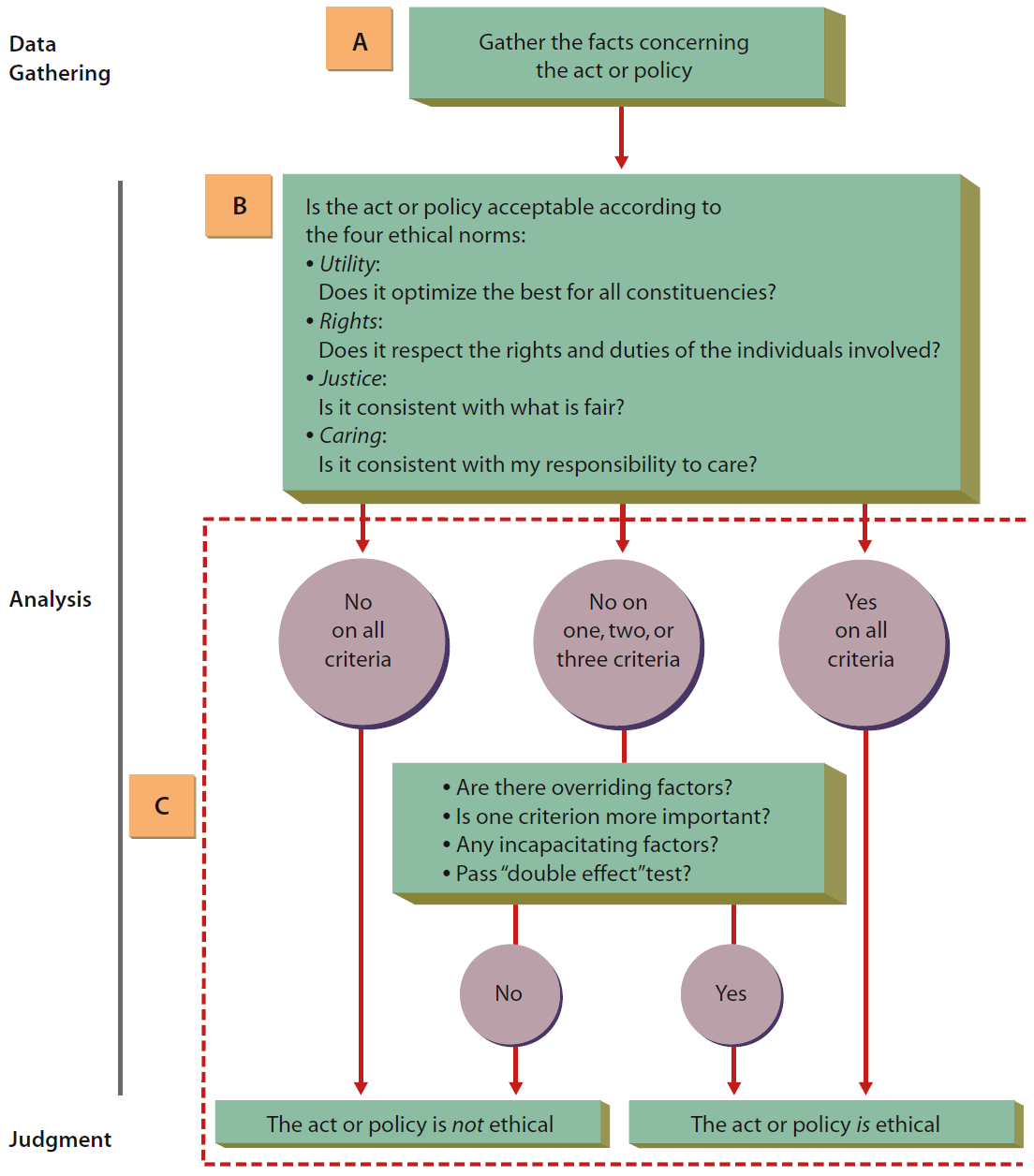
A Guide for Ethical Decision Making

Slide 24
Social Responsibility
The Stakeholders
The Environment
Social Responsibility of Organizations
The General Social Welfare

Slide 25
Social Responsibility in Organizations
Social Responsibility
The set of obligations (to behave responsibly) that an organization has to protect and enhance the social context in which it functions.
Areas of Social Responsibility
Stakeholders: customers, employees, and investors.
The natural environment: environmentally sensitive products, recycling, and public safety.
The general social welfare: charitable contributions, and support for social issues such as child labor and human rights.

Slide 26
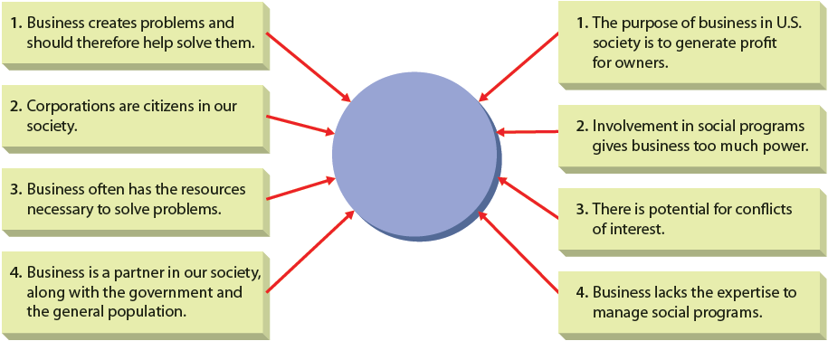
FIGURE 2.2
Arguments for and against Social Responsibility
Arguments for Social Responsibility
Arguments against Social Responsibility
Social Responsibility

Slide 27
Approaches to Social Responsibility
Highest Degree of Social Responsibility
Proactive Stance
Accommodative Stance
Defensive Stance
Obstructionist Stance
Lowest Degree of Social Responsibility

Slide 28
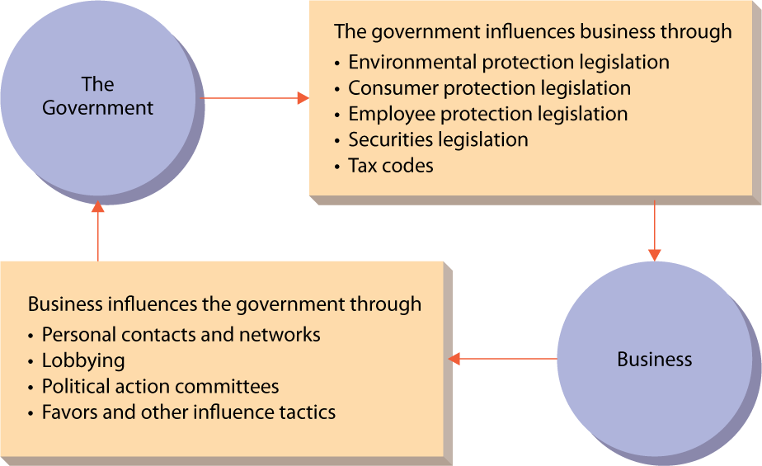
How Business and Government Influence Each Other

Slide 29
Managing Social Responsibility
Formal Organizational Dimensions
Informal Organizational Dimensions
Legal compliance
Organization leadership and culture
Ethical compliance
Whistle Blowing
Philanthropic giving

Slide 30
Managing Social Responsibility: Formal Organizational Dimensions
Legal Compliance
Extent to which the organization conforms to local, state, federal, and international laws.
Ethical Compliance
Extent to which members of the organization follow basic ethical/legal standards of behavior.
Philanthropic Giving
Awarding of funds or gifts to charities or other social programs.

Slide 31
Managing Social Responsibility: Informal Organizational Dimensions
Organizational Leadership and Culture
Leadership practices and the culture of the organization define the social responsibility stance an organization and its members will adopt.
Whistle Blowing
The organizational response to the disclosure by an employee of illegal or unethical conduct on the part of others within the organization is indicative of the organization’s stance on social responsibility.

Slide 32
Trends in International Business
Economic Recovery
Europe and Asia have rebuilt their economic systems devastated in WWII.
Decreasing Isolation from Foreign Competition
U.S. markets are open to overseas competitors.
Increasing Globalization of World Markets
Volume of international trade has increased more than 3,000% from 1960 to 2010.
Larger percentages of U.S. firms’ profits are now earned in international markets.

Slide 33
International Business Activity
Exporting
Types of International Business Activity
Importing
Licensing
Direct Investment
Alliances and Joint Ventures

Slide 34
Levels of International Business Activity
Exporting
Making a product in the firm’s domestic market and selling it in another country.
Importing
Bringing a good, service, or capital into a home country from abroad.
Licensing
Allowing a foreign company to manufacture or market the products and use a firm’s brand name, trademark, technology, patent, copyright, or other assets in exchange for a royalty based on sales.

Slide 35
Levels of International Business… (cont’d)
Strategic Alliance and Joint Ventures
Firms jointly cooperate for mutual gain, by sharing costs and/or sharing ownership of a new enterprise.
Direct Investment
Occurs when a firm headquartered in one country builds or purchases operating facilities or subsidiaries in a foreign country.
Maquiladoras
Light-assembly plants in northern Mexico which are given special tax breaks by the Mexican government.

Slide 36

Table 2.1
Advantages and Disadvantages of Different Approaches to Internationalization
Approach to Internationalization | Advantages | Disadvantages
Importing or Exporting | Small cash outlay Little risk No adaptation necessary | Tariffs and taxes High transportation costs Government restrictions
Licensing | Increased profitability Extended profitability | Inflexibility Competition
Strategic Alliances or Joint Ventures | Quick market entry Access to materials and technology | Shared ownership (limits control and profits)
Direct Investment | Enhanced control Existing infrastructure | Complexity Greater economic and political risk Greater uncertainty

Slide 37
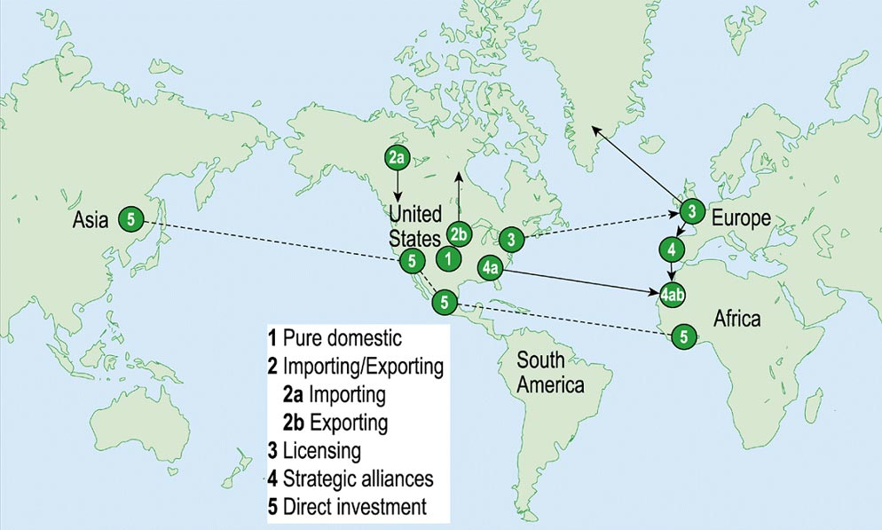
Forms of International Business Activity

Slide 38
The Context of International Management
Political/Legal Environment
Government stability
Incentives for international trade
Controls on international trade
Economic communities
Economic Environment
Economic system
Natural resources
Infrastructure
Cultural Environment
Values, symbols, beliefs, and language
Individual differences across cultures
International Management Functions

Slide 39
The Cultural Environment
Language
The Japanese word “hai” can mean either “yes” or “I understand.”
General Motors’ brand name “Nova” pronounced as “no va” in Spanish means “doesn’t go.”
The Meaning of Colors
Green is popular in Muslim countries, yet it signifies death in other countries.
Pink is associated with feminine characteristics in the U.S.; yellow is the most feminine color in other countries.

Slide 40
Controls on International Trade
Key Concepts
Tariffs are taxes collected on goods shipped across national boundaries.
Quotas are limits placed on the number or value of goods that can be traded as exports or imports.
Export restraint agreements are voluntary limits on the volume or value of goods exported to, or imported from, another country.

Slide 41
The Structure of the Global Economy
Economic Communities
Sets of countries that engage in high levels of trade with each other through the elimination of trade barriers such as quotas and tariffs.
European Union (EU)
North American Free Trade Agreement (NAFTA)
Latin American Integration Association
Caribbean Common Market

Slide 42
The Role of the GATT and the WTO
General Agreement on Trade and Tariffs (GATT)
A trade agreement that promoted international trade by lowering trading barriers and tariffs.
World Trade Organization (WTO)
Encourages adoption of nondiscriminatory and predictable trade policies.
Seeks to reduce trade barriers through multilateral negotiations.
Attempts to resolve trade disputes through impartial procedures

Slide 43
The Organization’s Culture
Organization Culture
The collection of values, beliefs, behaviors, customs, and attitudes that characterize a community of people.
The Importance of Organization Culture
Culture determines the overall “feel” of the organization, although it may vary across different segments of the organization.
Culture is a powerful force that can shape the organization’s overall effectiveness and long-term success.

Slide 44
Determinants of Organization Culture
Organization’s founder (personal values and beliefs).
Symbols, stories, heroes, slogans, and ceremonies that embody and personify the spirit of the organization.
Corporate success that strengthens the culture.
Shared experiences that bond organizational members together.

Slide 45
Managing Organization Culture
Understand the current culture to understand whether to maintain or change it.
Articulate the culture through slogans, ceremonies, and shared experiences.
Reward and promote people whose behaviors are consistent with desired cultural values.

Slide 46
Changing Organization Culture
Develop a clear idea of what kind of culture you want to create.
Bring in outsiders to important managerial positions.
Adopt new slogans, stories, ceremonies, and purposely break with tradition.

